Slide 1
TWO DIMENSIONAL TRANSFORMATION

Slide 2
CONTENT
TRANSFORMATION PRINCIPLES
CONCATENATION
MATRIX REPRESENTATIONS
RM
[6]-<number>

Slide 3
Transformation
Transform every point on an object according to certain rule.
Q (x’, y’)
P (x,y)
T
Initial Object
Transformed Object
x x’
y y’
The point Q is the image of P under the transformation T.
RM
[6]-<number>

Slide 4
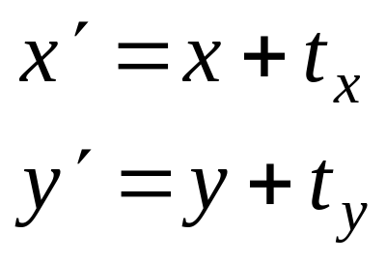
Translation
(55,60)
(20,35)
(45,30)
(65,30)
(10,5)
(30,5)
The vector (t_{x}, t_{y}) is called the offset vector.
RM
[6]-<number>

Slide 5
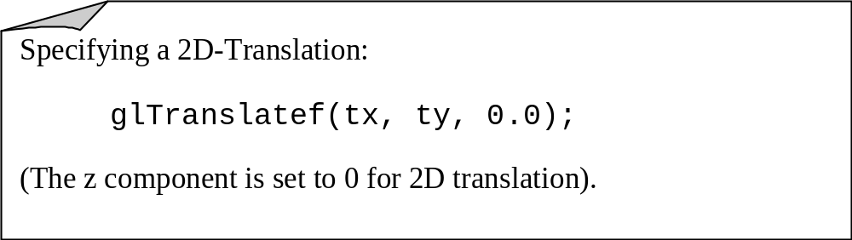
Translation (OpenGL)
RM
[6]-<number>

Slide 6
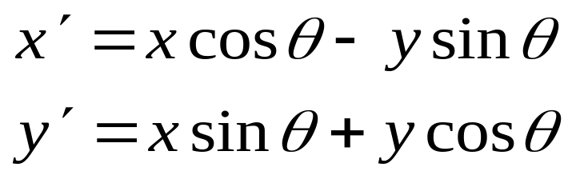
Rotation About the Origin
y
(x’,y’)
(x’,y’)
(x,y)
(x,y)
θ
o
x
The above 2D rotation is actually a rotation about the z-axis (0,0,1) by an angle θ.
RM
[6]-<number>

Slide 7
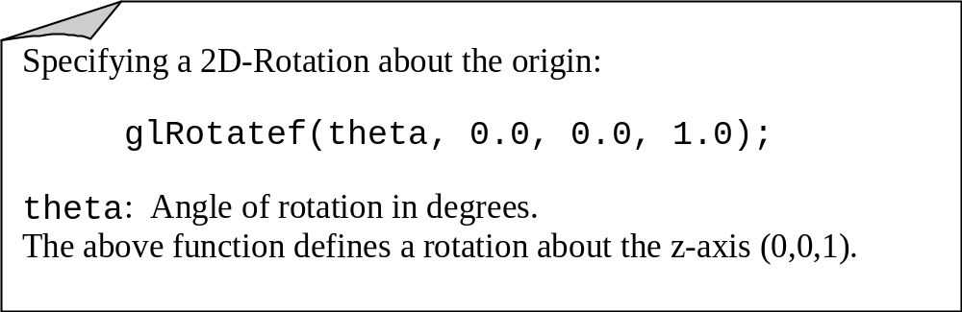
Rotation About the Origin
RM
[6]-<number>

Slide 8
Rotation About a Pivot Point
(x’,y’)
(x,y)
(x_{p} , y_{p})
Pivot Point
Pivot point is the point of rotation
Pivot point need not necessarily be on the object
RM
[6]-<number>

Slide 9
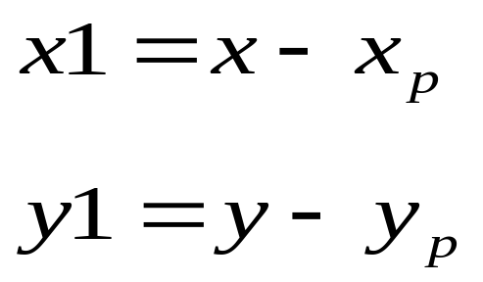
Rotation About a Pivot Point
STEP-1: Translate the pivot point to the origin
(x,y)
(x1, y1)
(x_{p} , y_{p})
RM
[6]-<number>

Slide 10
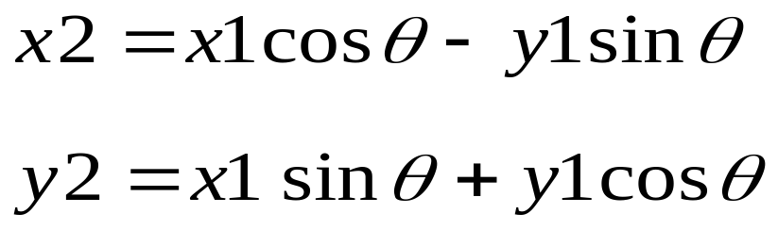
Rotation About a Pivot Point
STEP-2: Rotate about the origin
(x2, y2)
(x1, y1)
RM
[6]-<number>

Slide 11
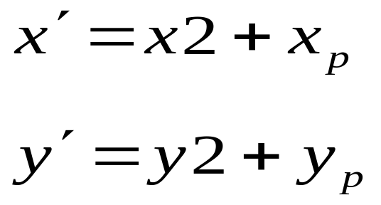
Rotation About a Pivot Point
STEP-3: Translate the pivot point to original position
(x’, y’)
(x2, y2)
(x_{p}, y_{p})
RM
[6]-<number>

Slide 12
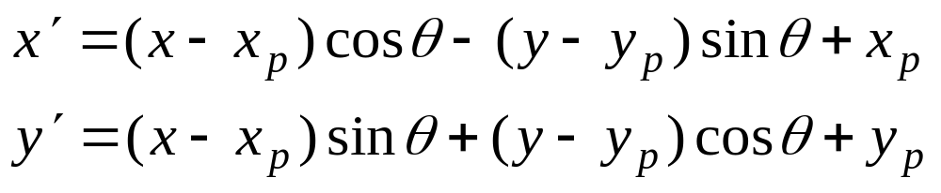
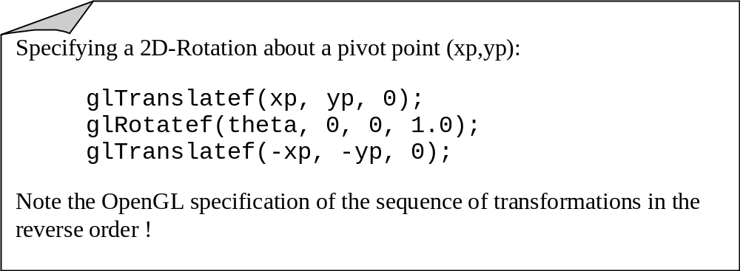
Rotation About a Pivot Point
RM
[6]-<number>

Slide 13
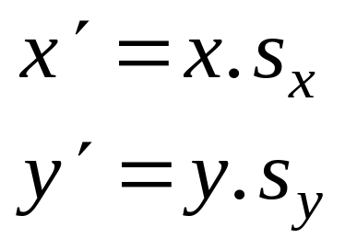
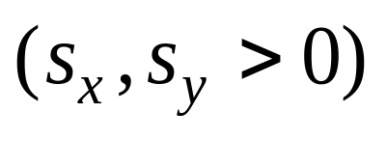
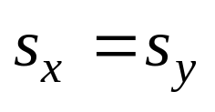
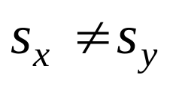
Scaling About the Origin
(x’,y’)
(x,y)
(x,y)
(x’,y’)
Uniform
Non-Uniform
The parameters s_{x}, s_{y} are called scale factors.
RM
[6]-<number>

Slide 14
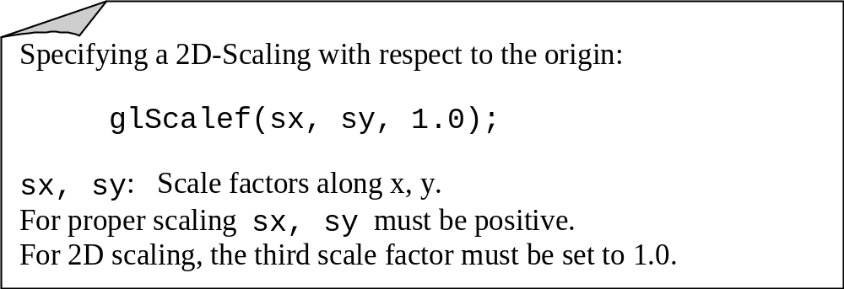
Scaling About the Origin
RM
[6]-<number>

Slide 15
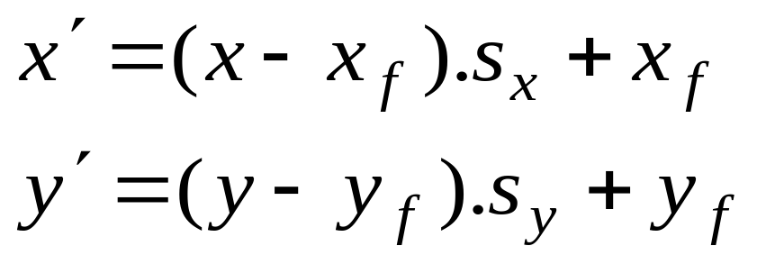
Scaling About a Fixed Point
Translate the fixed point to origin
Scale with respect to the origin
Translate the fixed point to its original
position.
(x,y)
(x’,y’)
(x_{f} , y_{f} )
RM
[6]-<number>

Slide 16
Reflections
y
Reflection about y
x′ = − x
Initial
Object
x
Reflection about
origin
x′ = − x
y′ = − y
Reflection about x
y′ = − y
RM
[6]-<number>

Slide 17
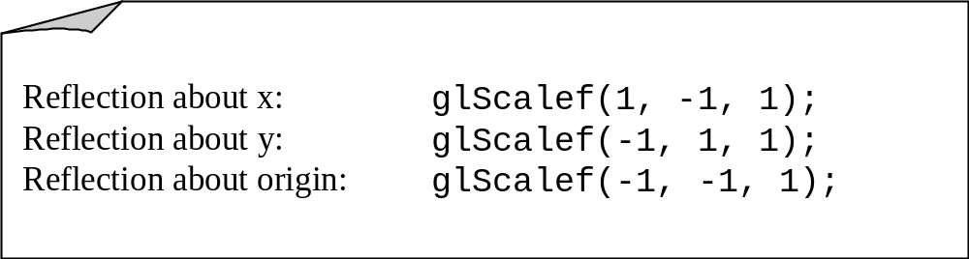
Reflections
RM
[6]-<number>

Slide 18
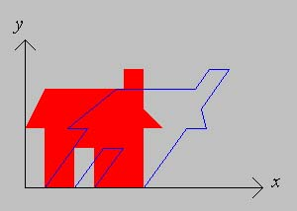
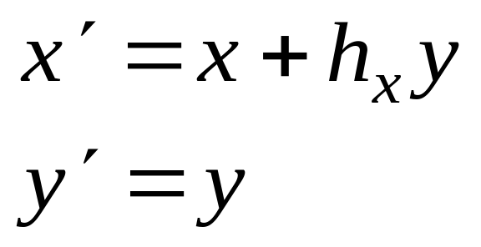
Shear
A shear transformation in the x-direction (along x)
shifts the points in the x-direction proportional
to the y-coordinate.
The y-coordinate of each point is unaffected.
RM
[6]-<number>

Slide 19
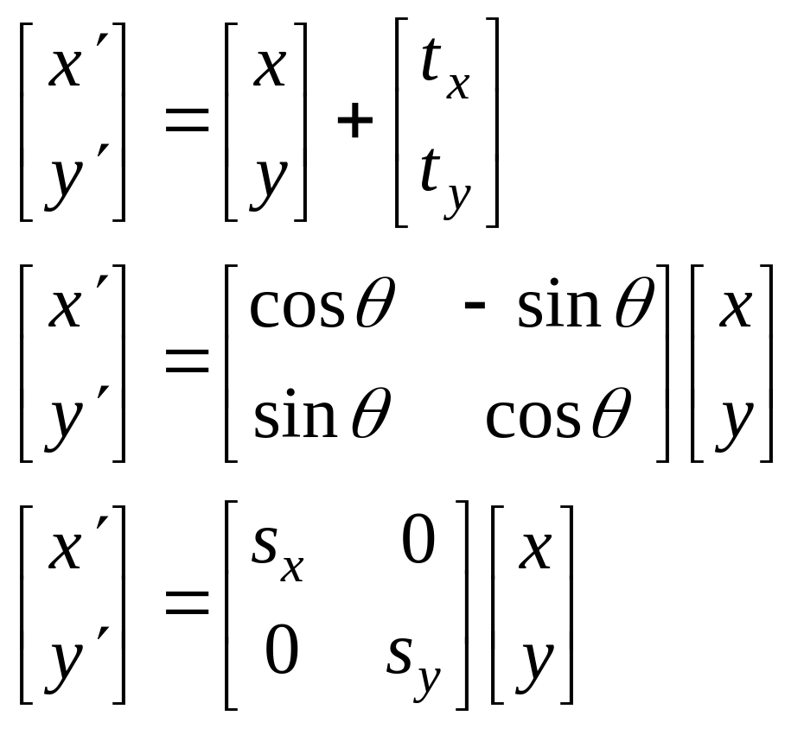
Matrix Representations
Translation
Rotation [Origin]
Scaling [Origin]
RM
[6]-<number>

Slide 20
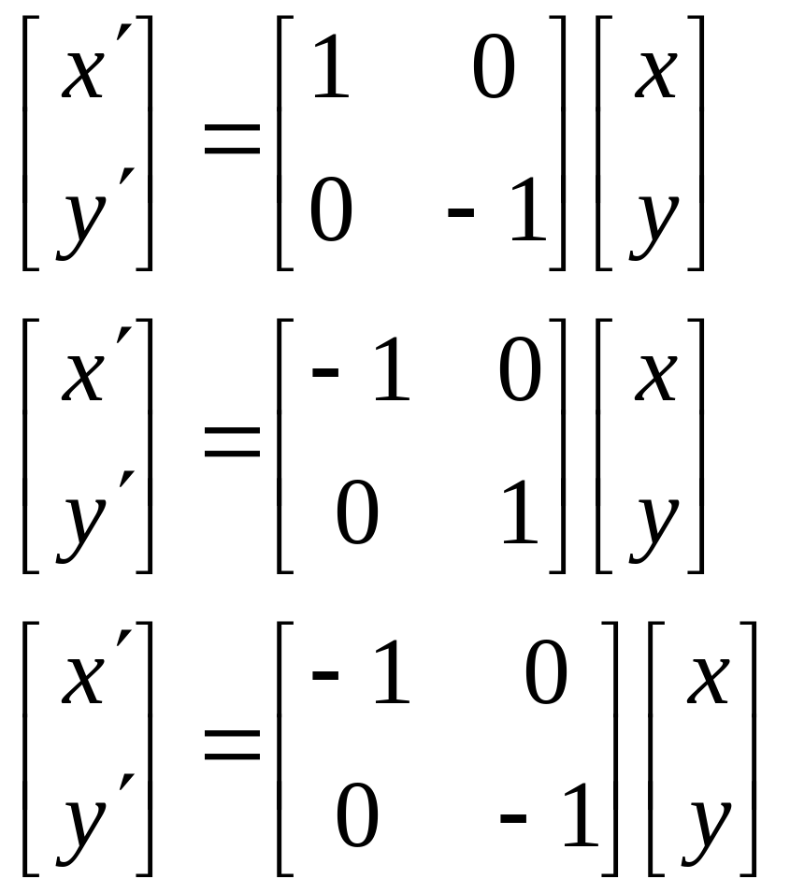
Matrix Representations
Reflection about x
Reflection about y
Reflection about
the Origin
RM
[6]-<number>

Slide 21
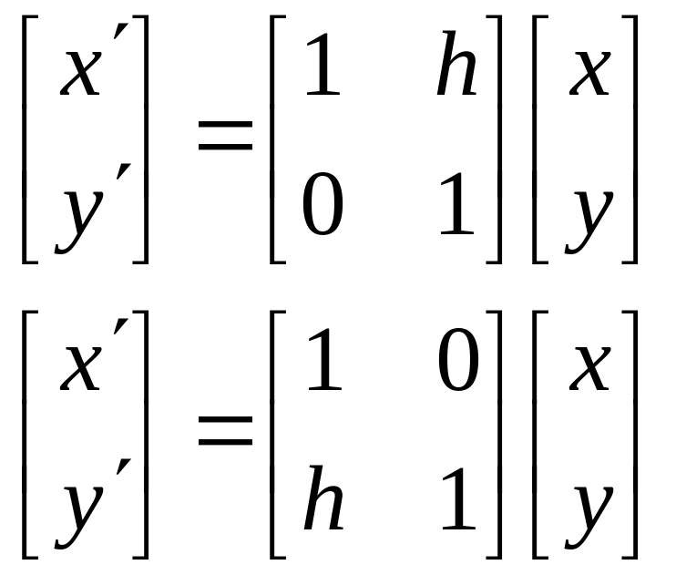
Matrix Representations
Shear along x
Shear along y
RM
[6]-<number>

Slide 22
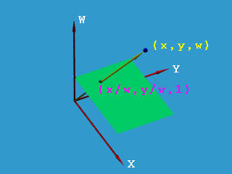
Homogeneous Coordinates
To obtain square matrices an additional row was added to the matrix and an additional coordinate, the w-coordinate, was added to the vector for a point. In this way a point in 2D space is expressed in three-dimensional homogeneous coordinates.
This technique of representing a point in a space whose dimension is one greater than that of the point is called homogeneous representation. It provides a consistent, uniform way of handling affine transformations.
RM
[6]-<number>

Slide 23
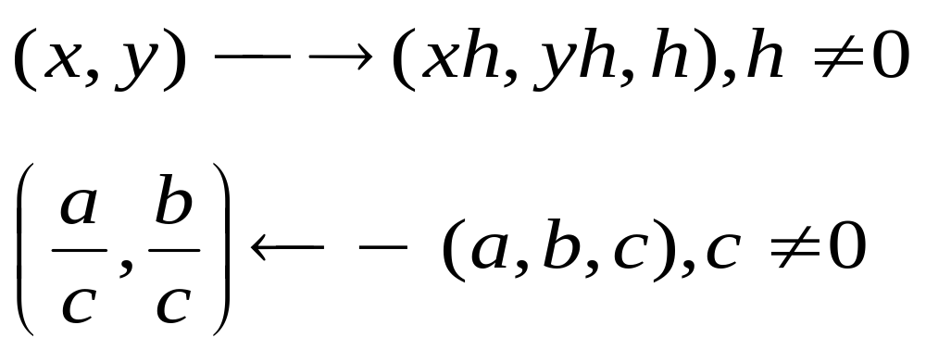
Homogeneous Coordinates
If we use homogeneous coordinates, the geometric transformations given above can be represented using only a matrix pre-multiplication.
A composite transformation can then be represented by a product of the corresponding matrices.
Cartesian Homogeneous
Examples: (5, 8) (15, 24, 3)
(x, y) (x, y, 1)
RM
[6]-<number>

Slide 24
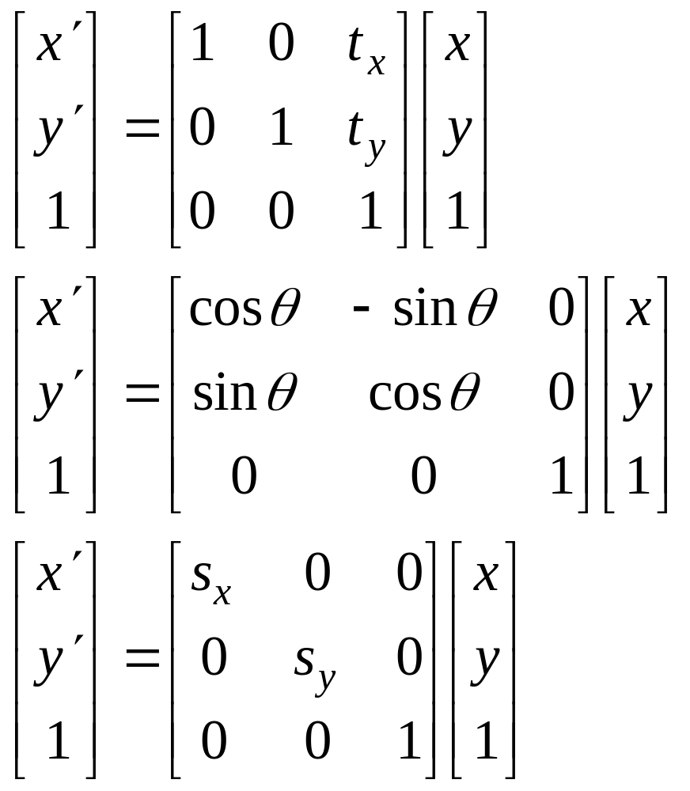
Homogeneous Coordinates
Basic Transformations
Translation
P’=TP
Rotation [O]
P’=RP
Scaling [O]
P’=SP
RM
[6]-<number>

Slide 25
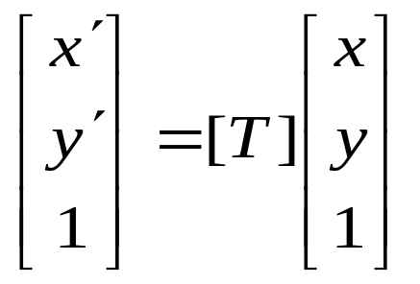
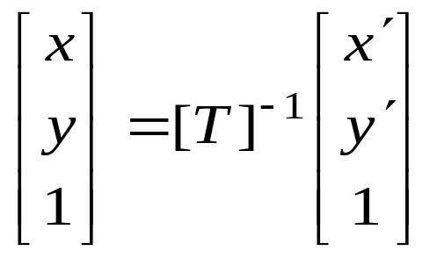
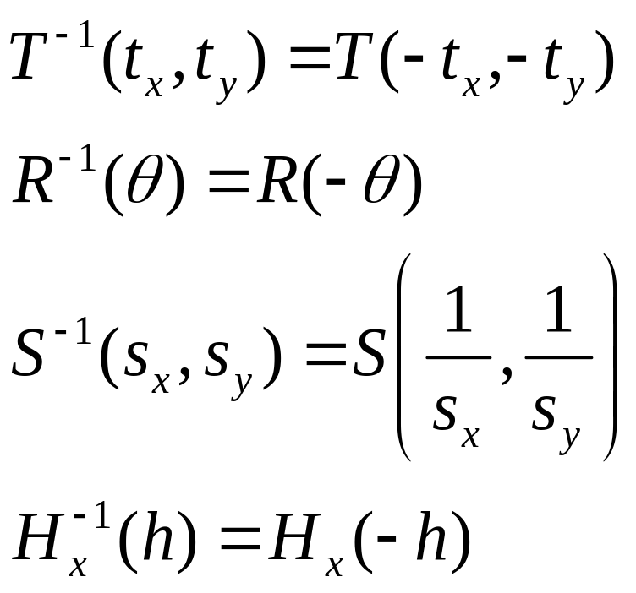
Inverse of Transformations
If,
then,
Examples:
RM
[6]-<number>

Slide 26
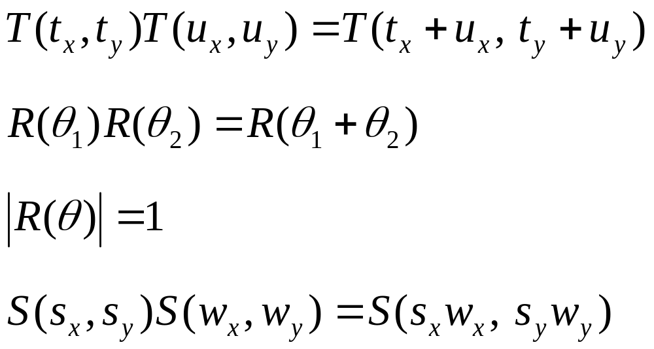
Transformation Matrices
Additional Properties:
RM
[6]-<number>

Slide 27
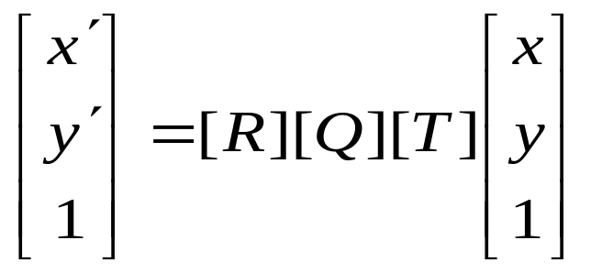
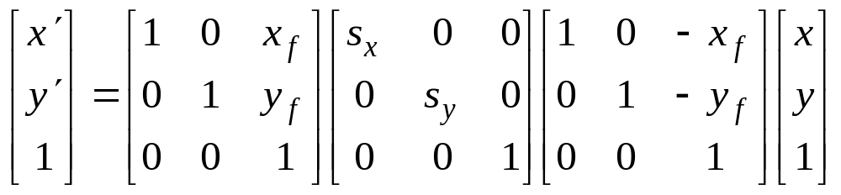
Composite Transformations
Transformation T followed by
Transformation Q followed by
Transformation R:
Example: (Scaling with respect to a fixed point)
Order of Transformations
RM
[6]-<number>

Slide 28
Order of Transformations
In composite transformations, the order of transformations is very important.
Rotation followed by Translation:
Translation followed by Rotation:
RM
[6]-<number>

Slide 29
Order of Transformations (OpenGL)
OpenGL postmultiplies the current matrix with the new transformation matrix
glMatrixMode(GL_MODELVIEW);
glLoadIdentity();
glTranslatef(tx, ty, 0);
glRotatef(theta, 0, 0, 1.0);
glVertex2f(x,y);
Current Matrix
[ I ]
[ T ]
[ T ] [ R ]
[ T ] [ R ] P
Rotation followed by Translation !!
RM
[6]-<number>

Slide 30
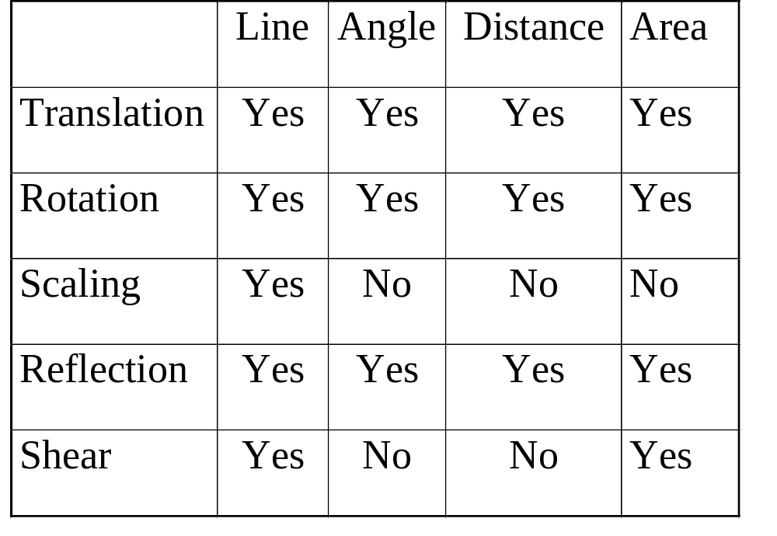
General Properties
Preserved Attributes
RM
[6]-<number>

Slide 31
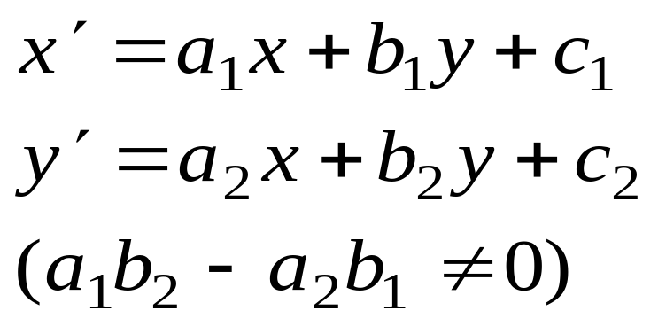
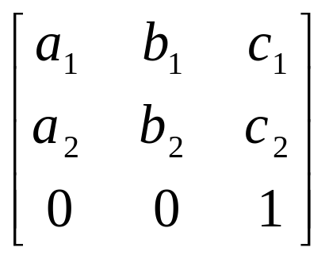
Affine Transformation
A general invertible, linear, transformation.
Transformation Matrix:
RM
[6]-<number>

Slide 32
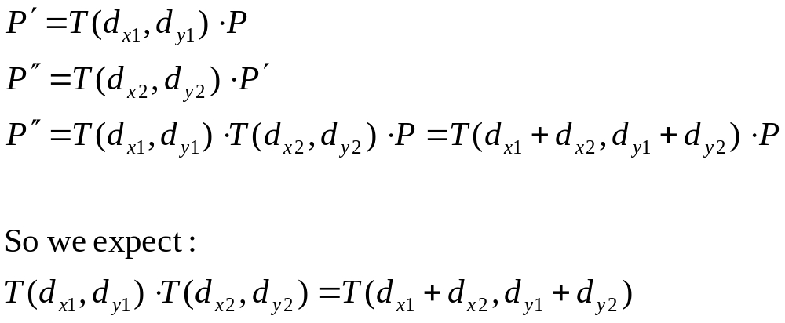
Concatenation.
We perform 2 translations on the same point:
12/12/2018
Lecture 4

Slide 33
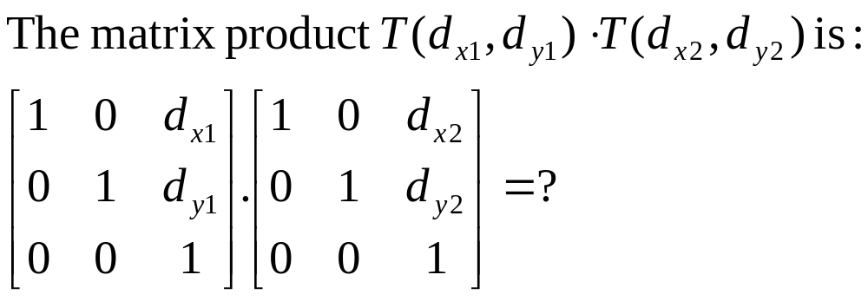
Concatenation.
Matrix product is variously referred to as compounding, concatenation, or composition
12/12/2018

Slide 34
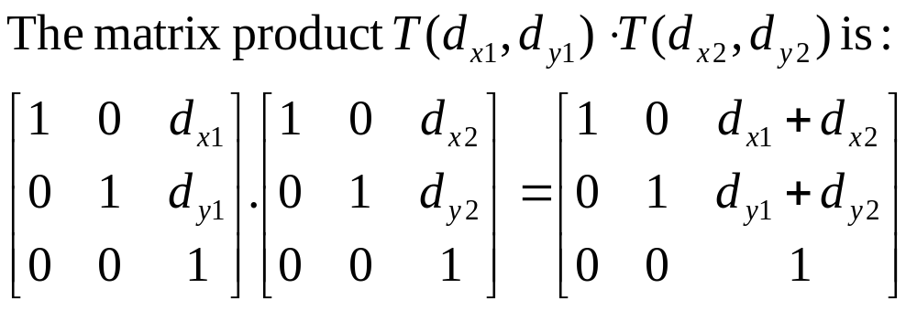
Concatenation.
Matrix product is variously referred to as compounding, concatenation, or composition.
12/12/2018
Lecture 4

Slide 35
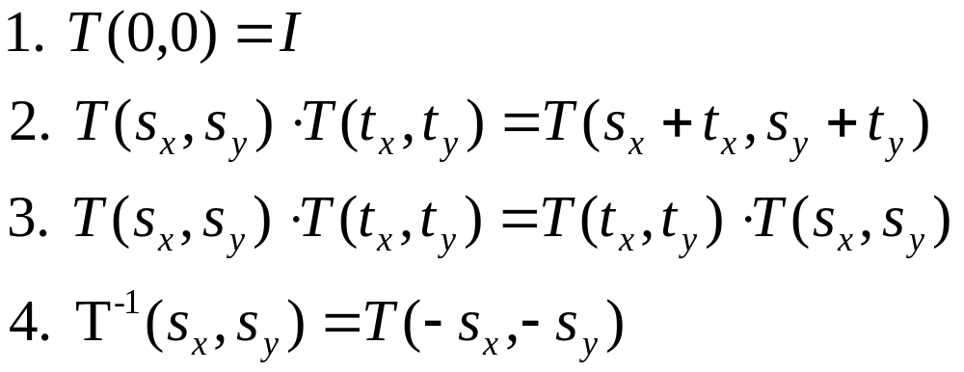
Properties of translations.
Note : 3. translation matrices are commutative.
12/12/2018
Lecture 4

Slide 36
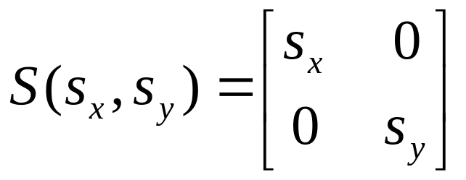
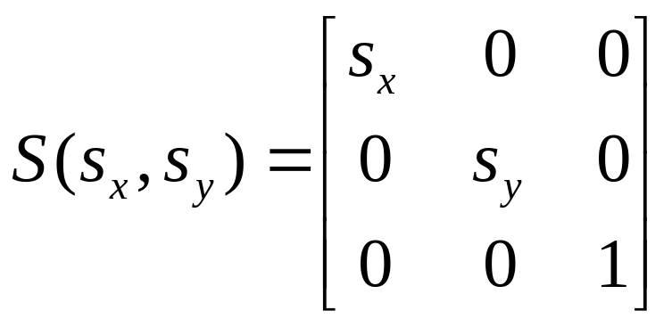
Homogeneous form of scale.
Recall the (x,y) form of Scale :
In homogeneous coordinates :
12/12/2018

